Slide 1


Trick and Tools of HTM/CSS
PROJECT OVERVIEW SHEVCHENKO ROMAN
DECEMBER 10, 2020

Slide 2
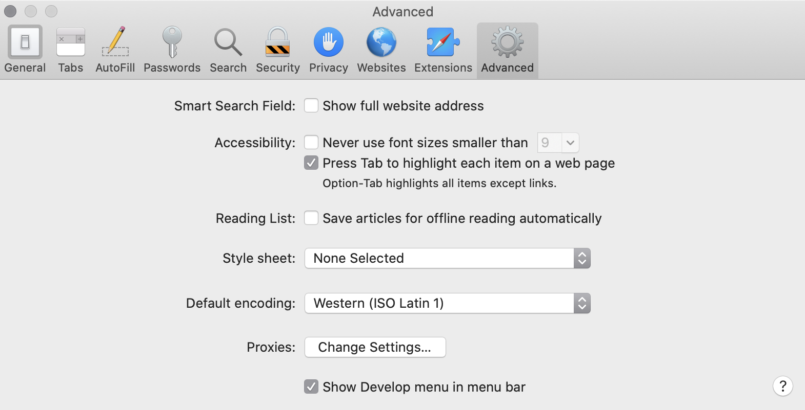
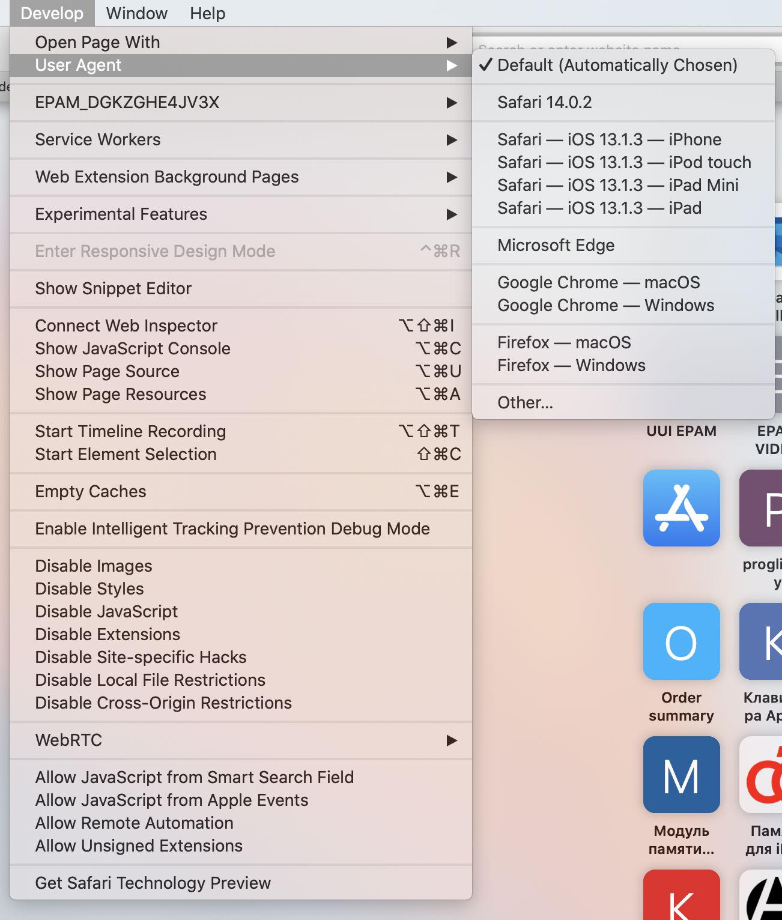

DEV TOOLS SAFARI

Slide 3

SAFARI Back BUTTON
(function () {
window.onpageshow = function(event) {
if (event.persisted) {
window.location.reload();
}
};
})();
function unloadingWebsite() {
// Do something just before the user leaves:
// Eg: Hide/close your menu/reset settings/clear cookies etc, whatever you need to do.
document.body.classList.add("unloaded");
}
window.addEventListener("pagehide", function() {
unloadingWebsite();
});
window.addEventListener("pageshow", function() {
// You can use the pageshow function if required to double ensure that everything is reset on the page load.
// Most of the time the "pagehide" event will provide the solution.
unloadingWebsite();
});

Slide 4
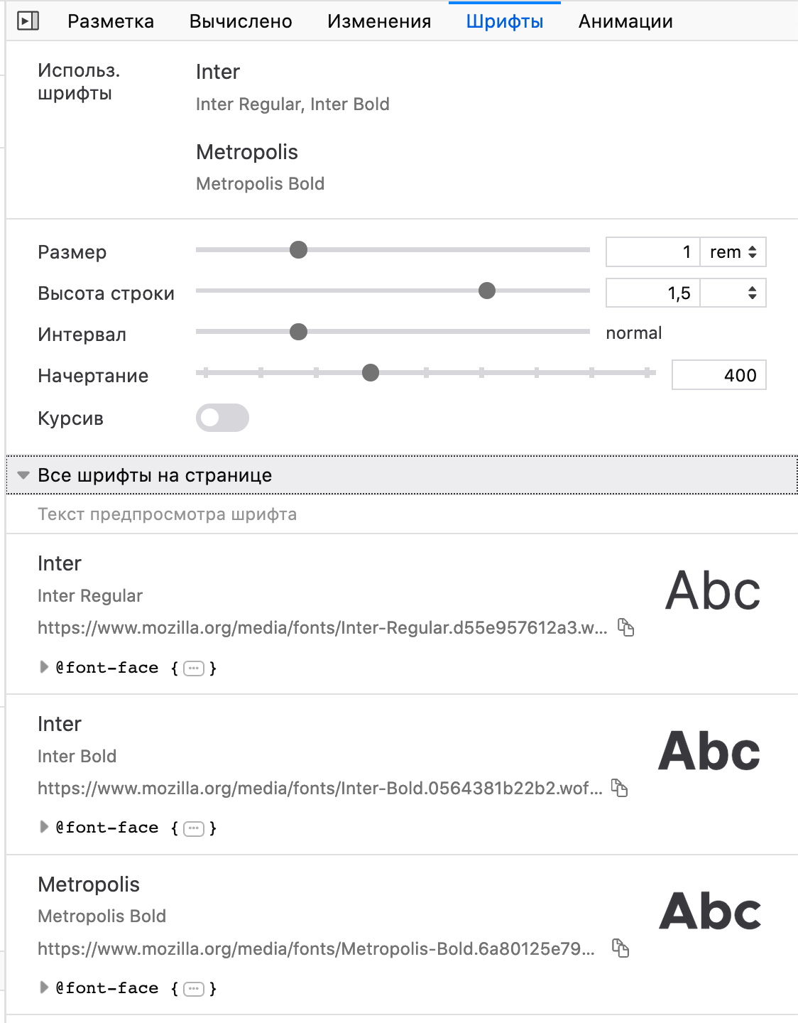
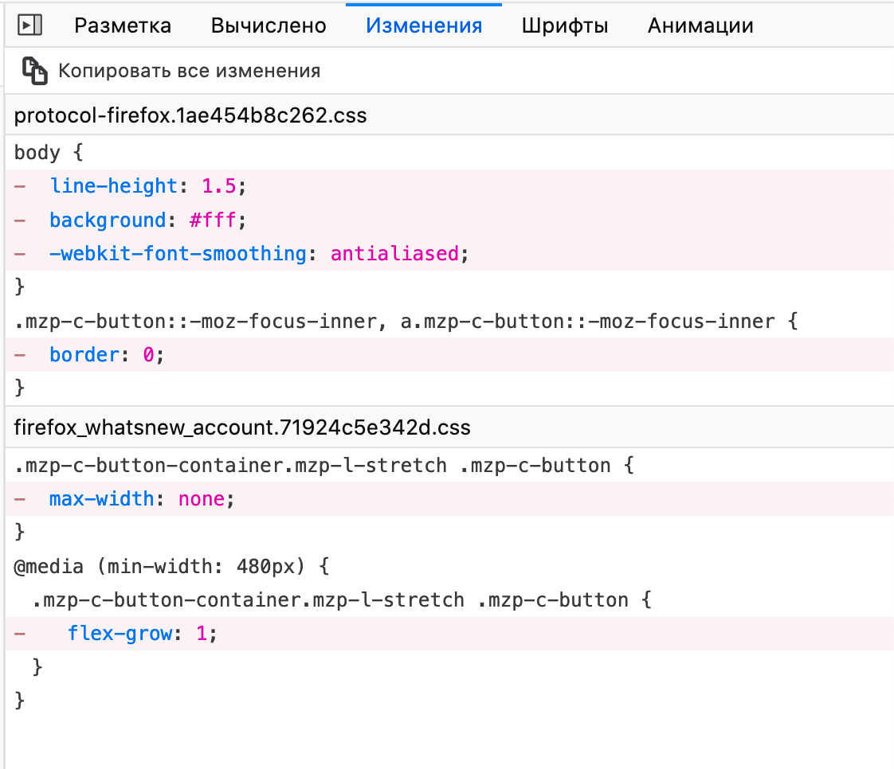
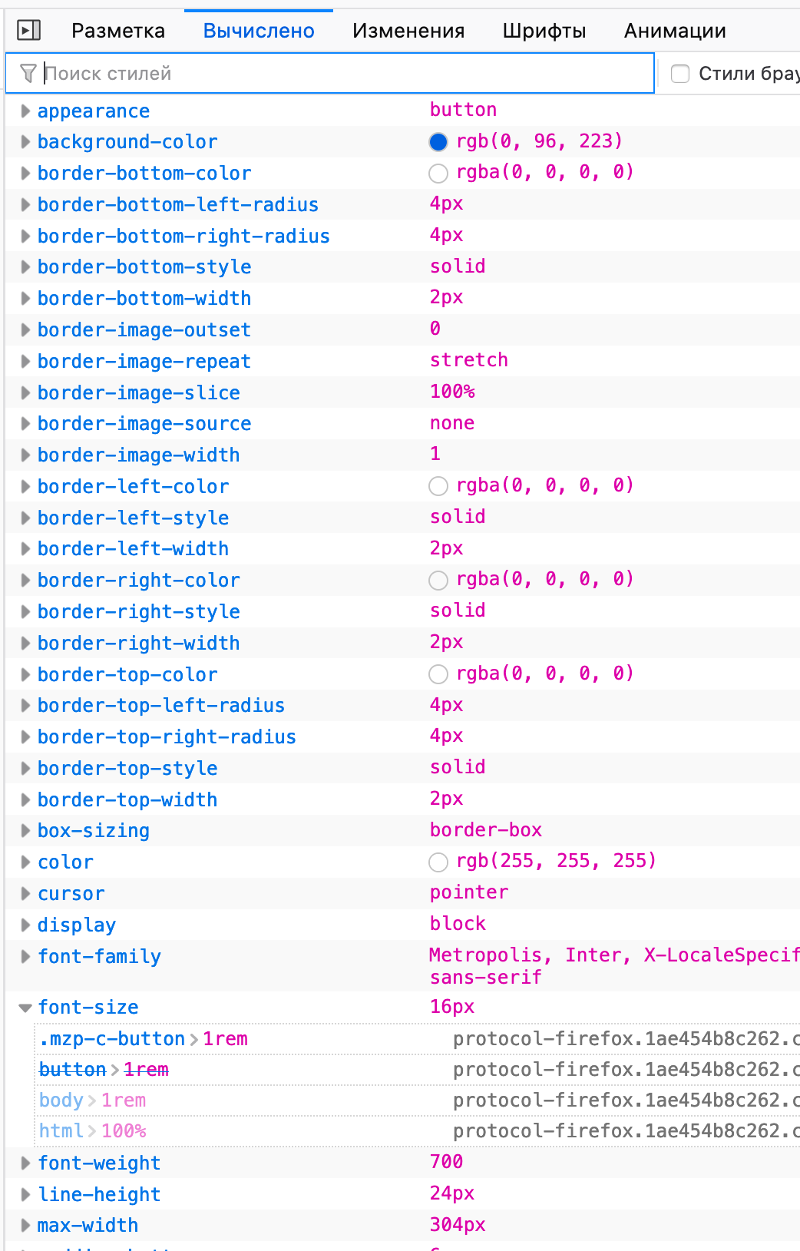
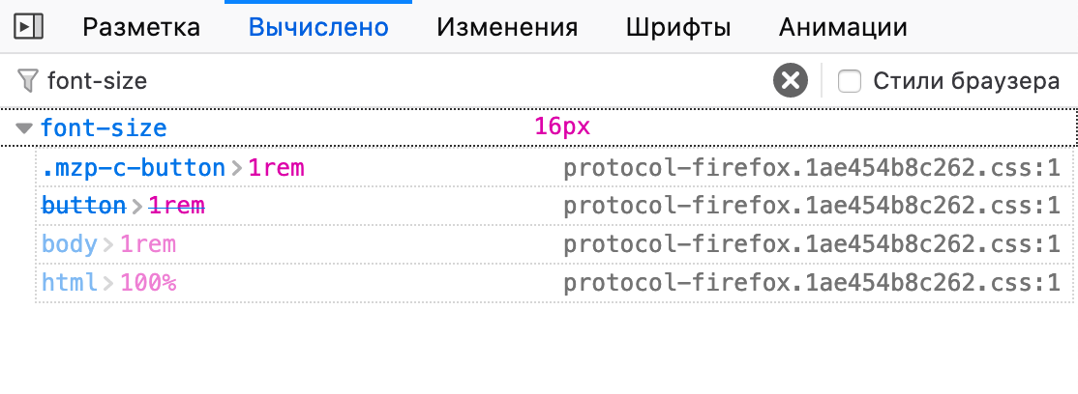
Firefox DEVTOOLS

Slide 5
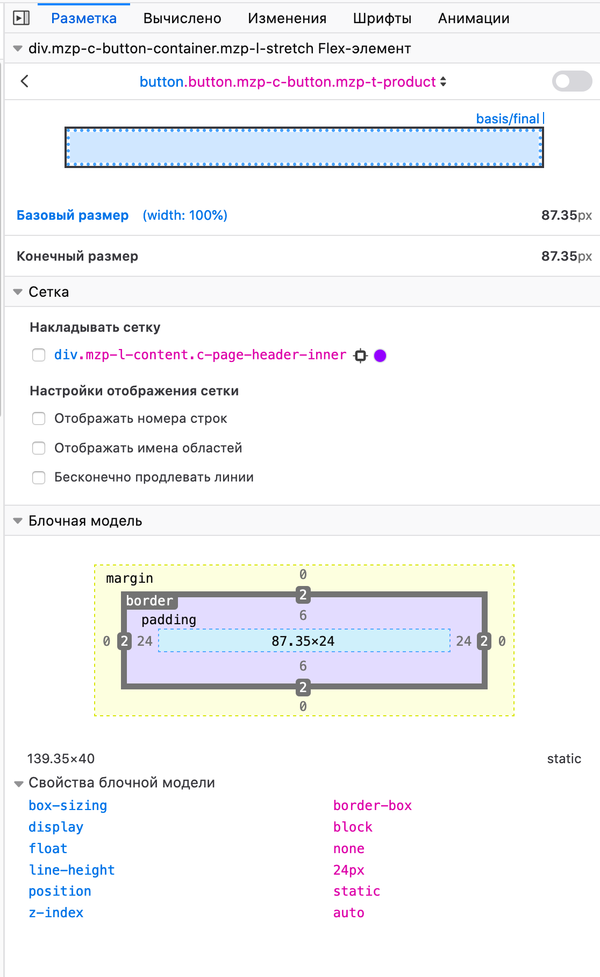
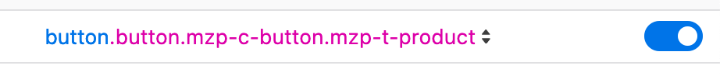

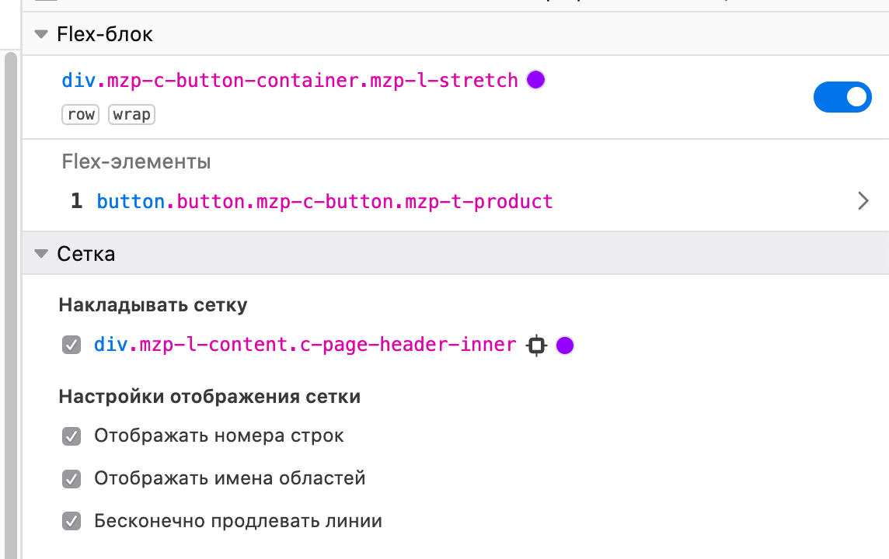
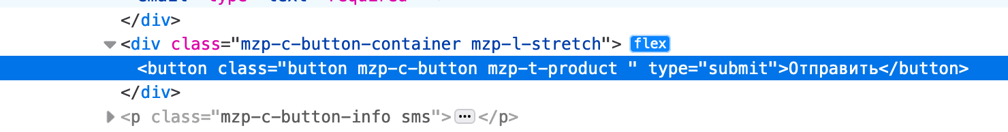
Firefox DEVTOOLS

Slide 6
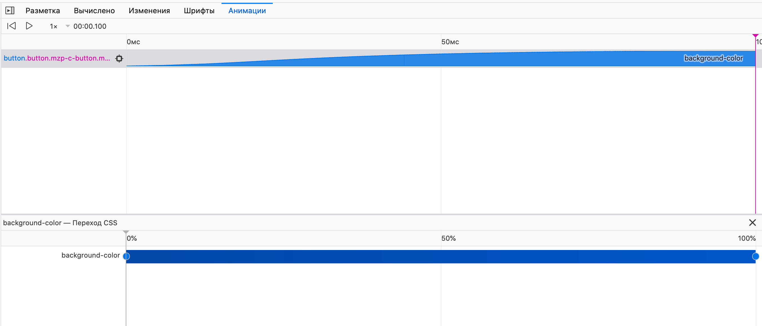
Firefox DEVTOOLS

Slide 7
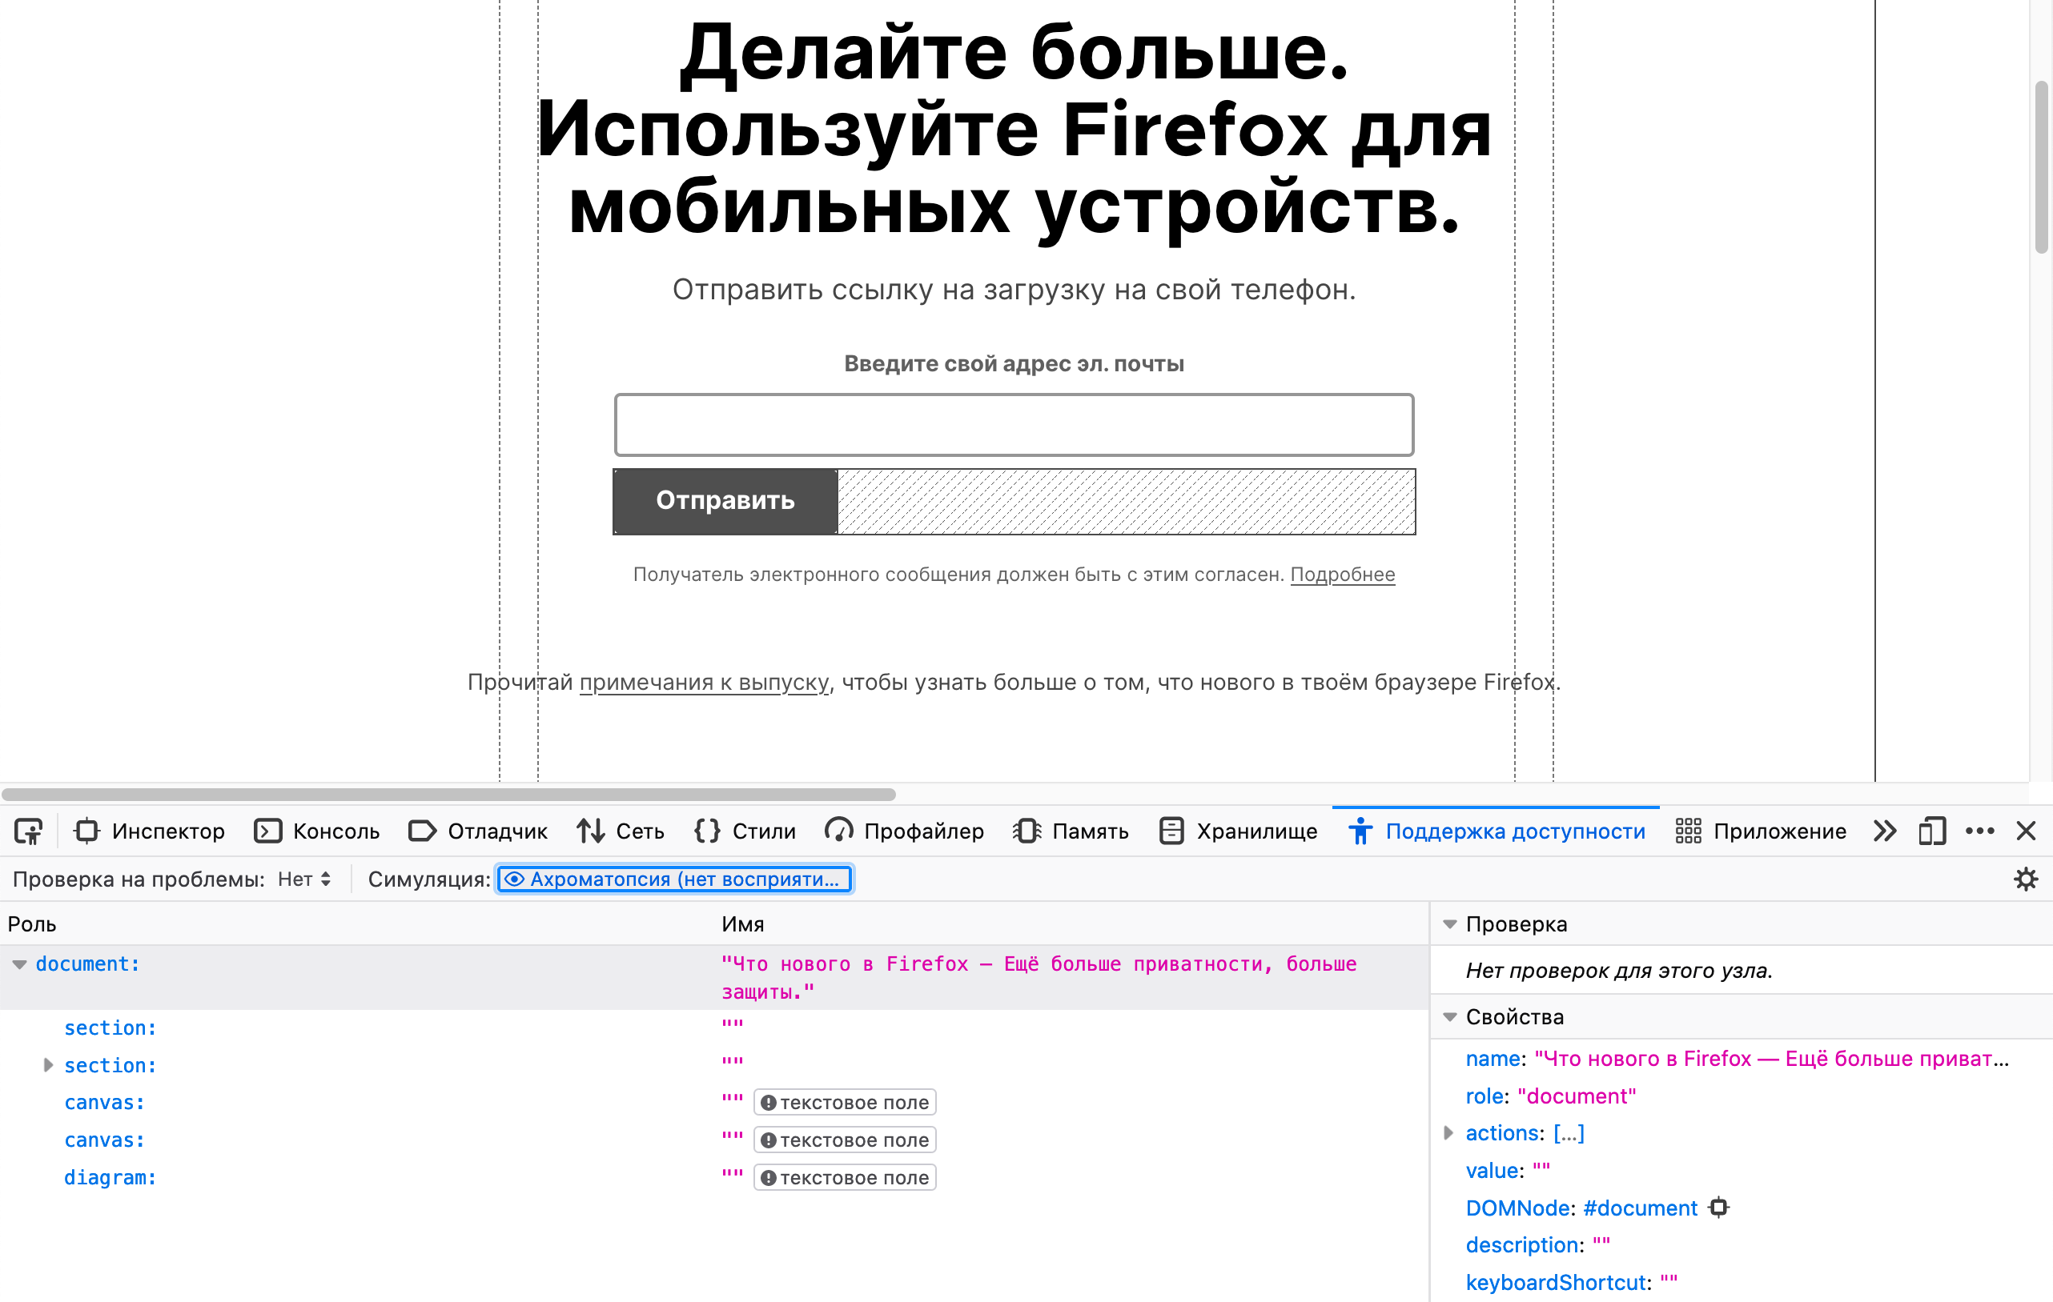
Firefox DEVTOOLS

Slide 8
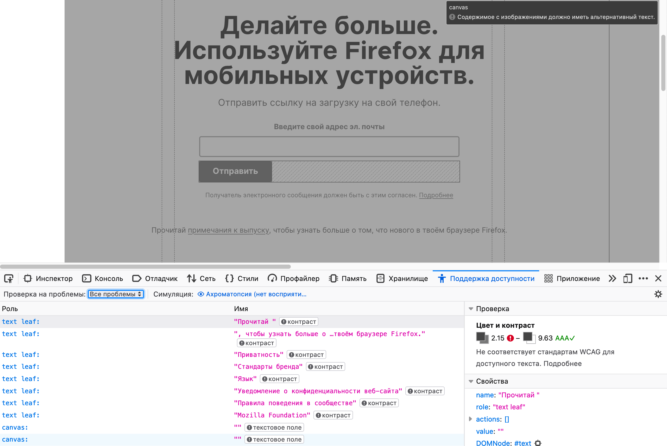
Firefox DEVTOOLS

Slide 9
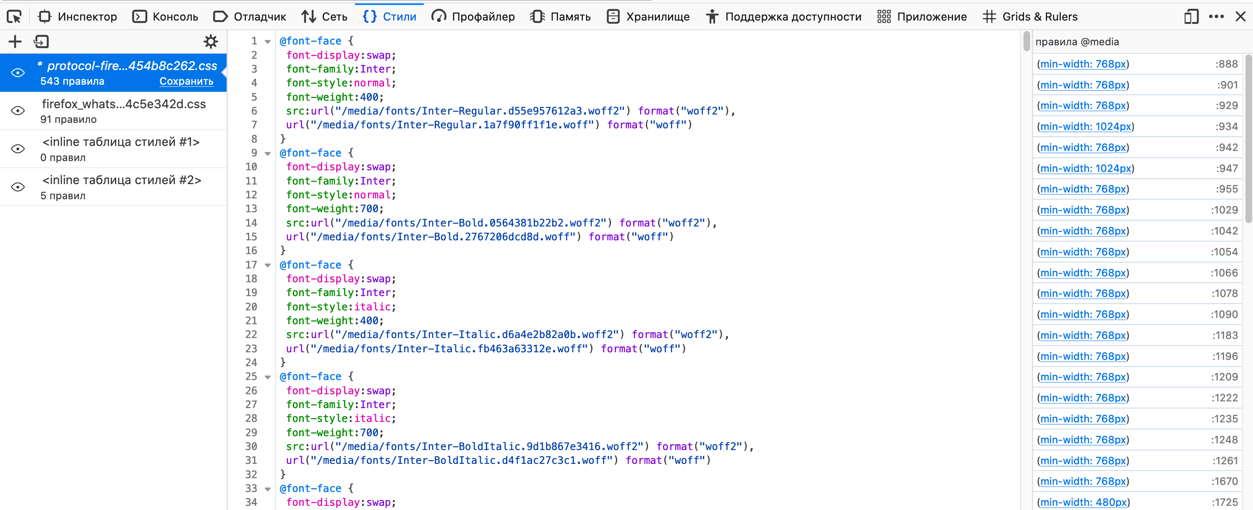
Firefox DEVTOOLS

Slide 10
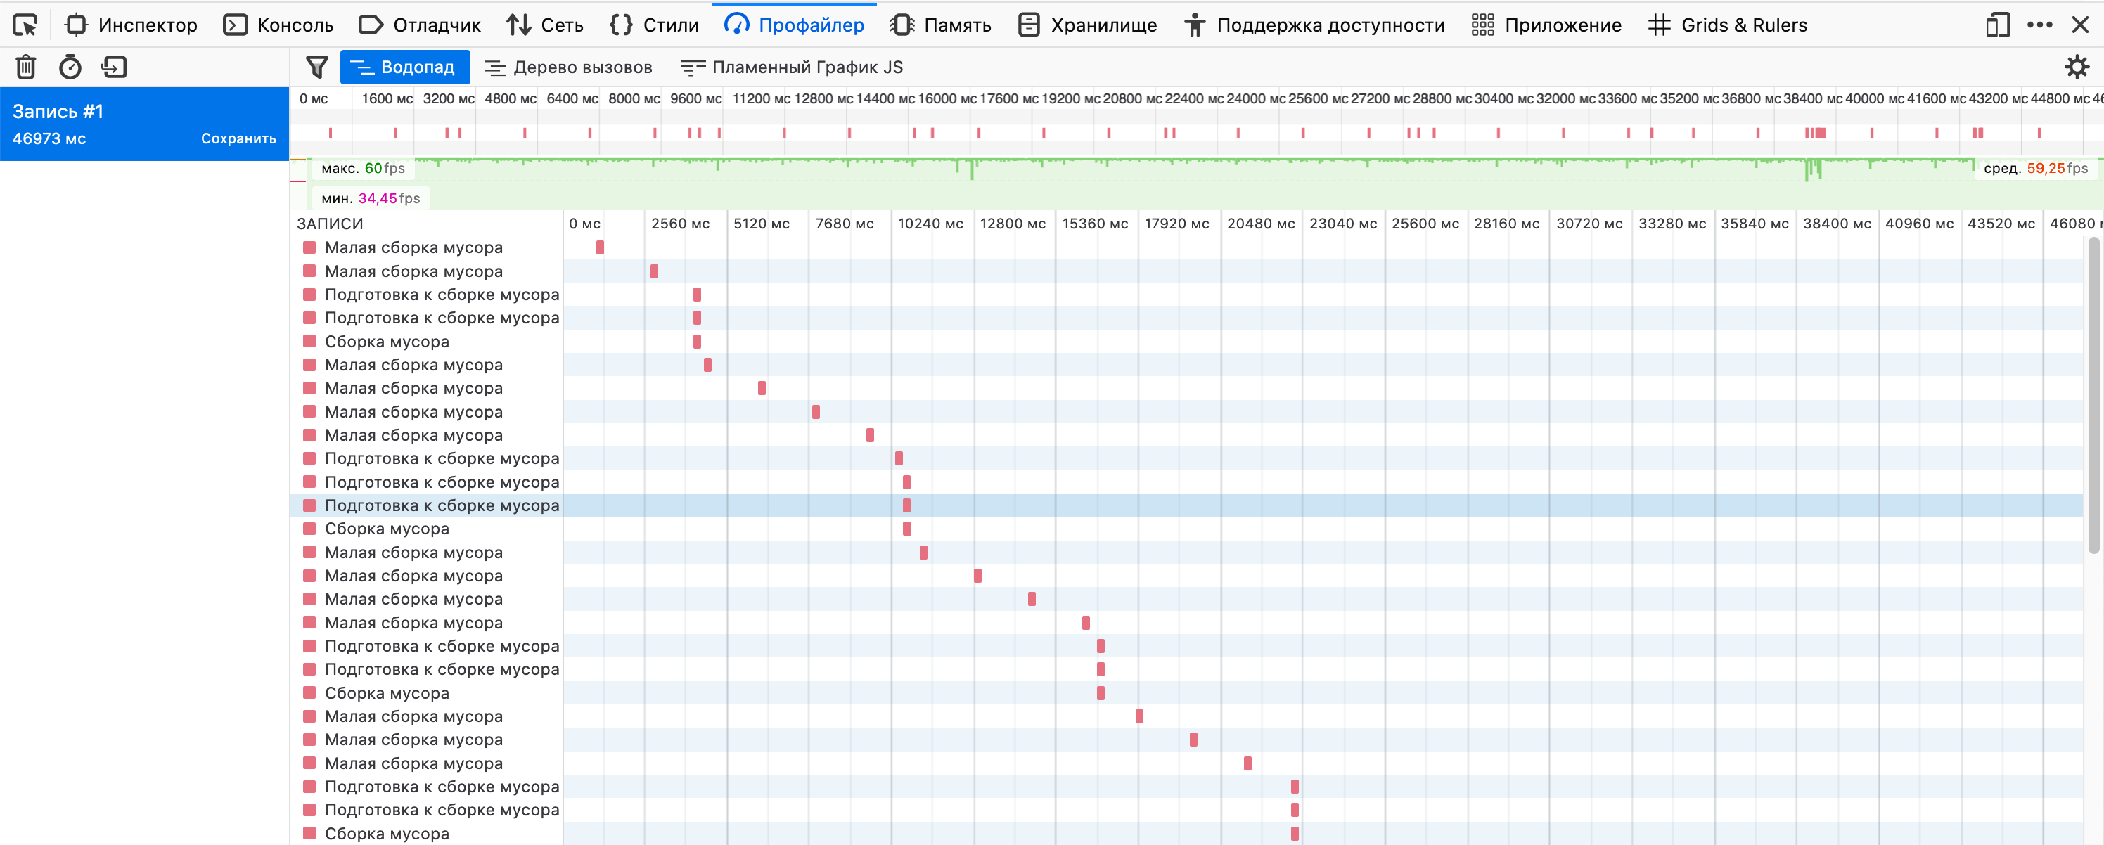
Firefox DEVTOOLS

Slide 11
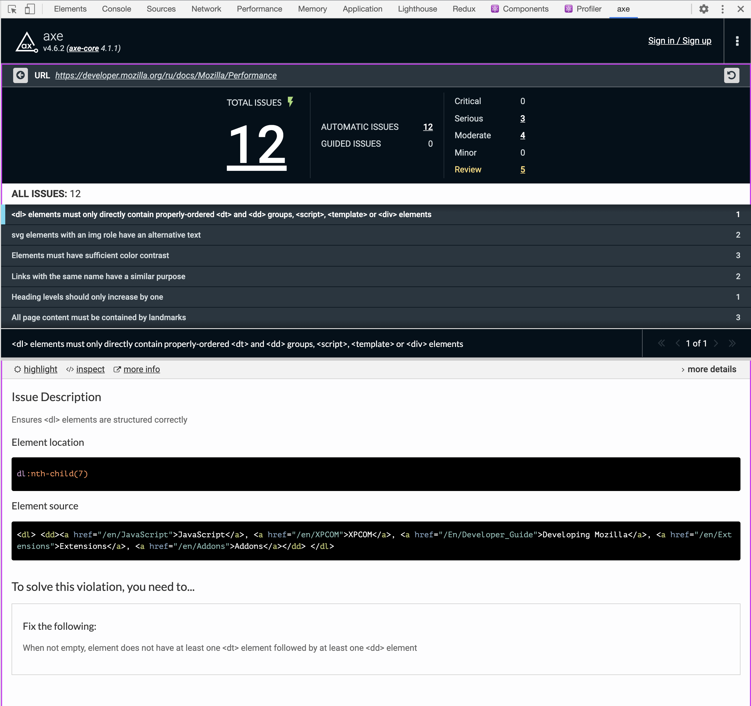
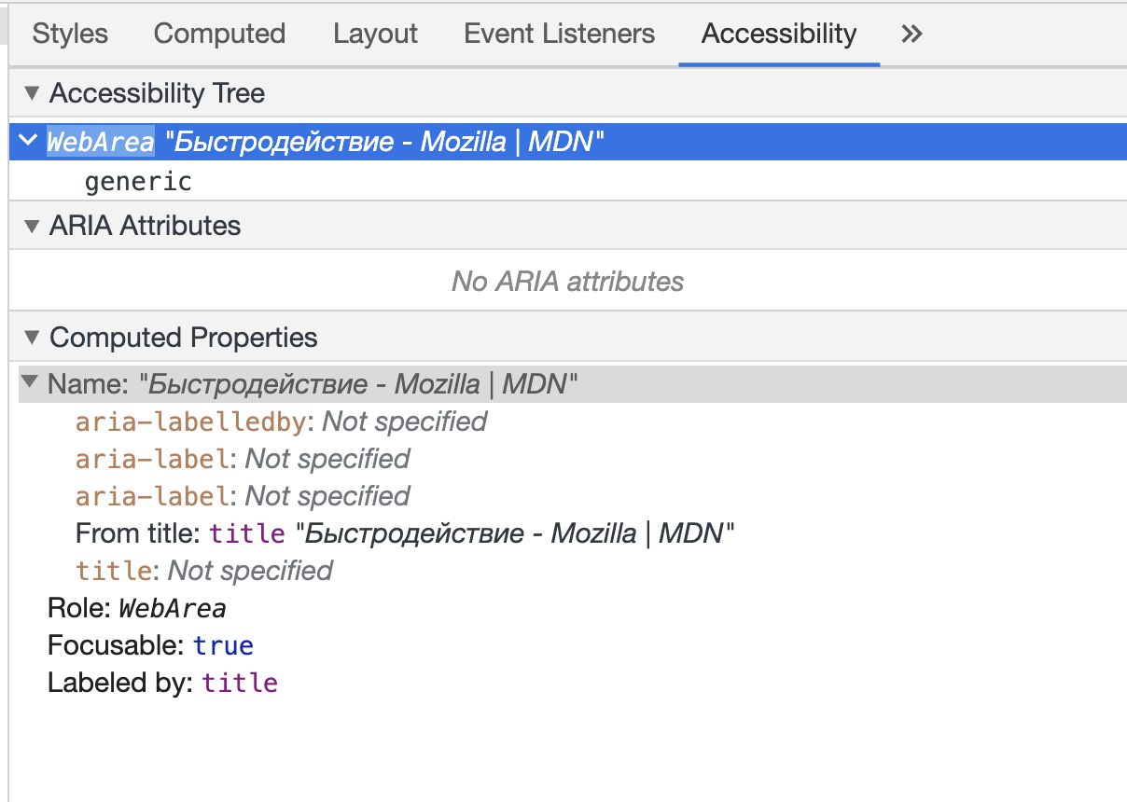
Chrome extensions

Slide 12
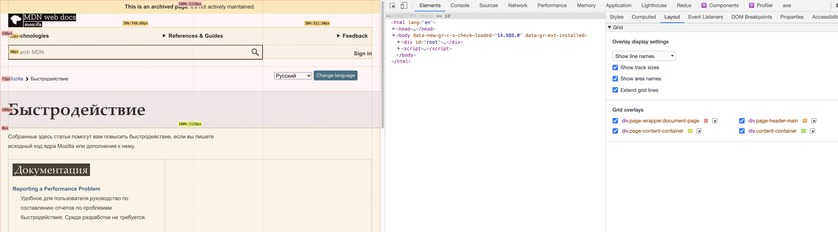
Chrome extensions

Slide 13
Chrome extensions
https://github.com/zalmoxisus/redux-devtools-extension#usage

Slide 14
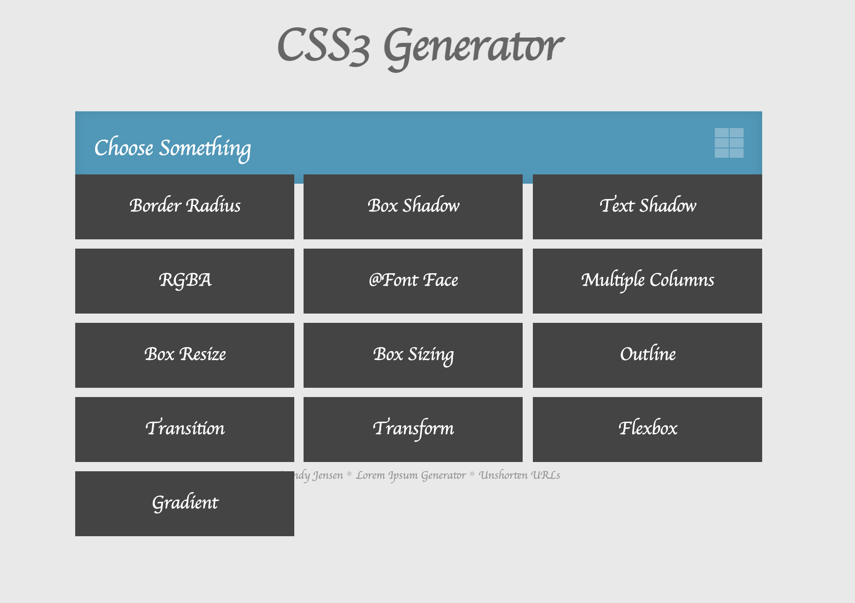

Generators of css3
https://css3generator.com/

Slide 15
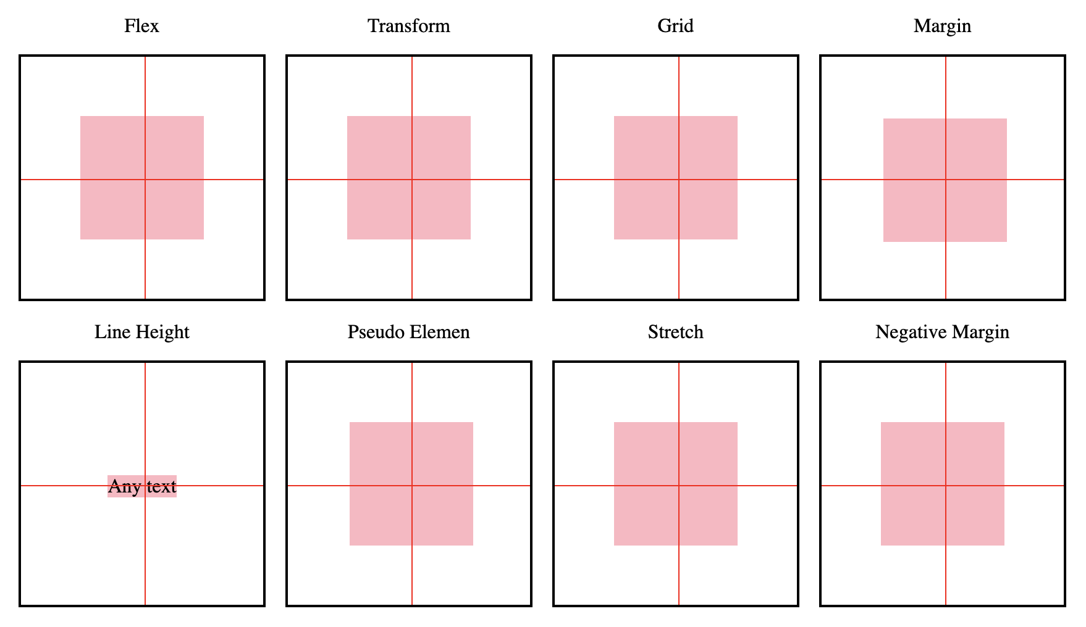
VERTICAL ALIGN

Slide 16
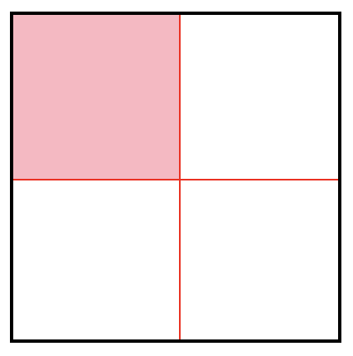
VERTICAL ALIGN
.parent {
$size: 200px;
height: $size;
width: $size;
border: 2px solid black;
box-sizing: border-box;
}
.child {
height: 100px;
width: 100px;
background: lightpink;
}

Slide 17
VERTICAL ALIGN - flex
.flex {
display: flex;
align-items: center;
justify-content: center;
}

Slide 18
VERTICAL ALIGN - margin
.margin {
// We know HEIGHT of parent and of child
.child {
height: $size/2;
margin: $size/2/2;
}
}

Slide 19
VERTICAL ALIGN - line-height
.line-height {
line-height: $size;
// optional
text-align: center;
.child {
white-space: nowrap;
overflow: hidden;
//inline, upset
display: unset;
}
}
<div class="item">
<span>Line Height</span>
<div class="parent line-height">
<span class="child">Any text</span>
</div>
</div>

Slide 20
VERTICAL ALIGN - Pseudo Elemen
.pseudo-element {
// optional
text-align: center;
&:before {
display: inline-block;
height: 100%;
vertical-align: middle;
content: "";
}
.child {
display: inline-block;
vertical-align: middle;
}
}

Slide 21
VERTICAL ALIGN - stretch
.stretch {
position: relative;
.child {
height: $size/2;
position: absolute;
top: 0;
bottom: 0;
// auto 0 OR just auto
margin: auto;
//optional
left: 0;
right: 0;
}
}

Slide 22
VERTICAL ALIGN - Negative Margin
.negative-margin {
position: relative;
.child {
height: $size/2;
position: absolute;
top: 50%;
margin-top: $size/2/2 * (-1);
//optional
left: 50%;
margin-left: $size/2/2 * (-1);
}
}

Slide 23
VERTICAL ALIGN - transform
.transform {
position: relative;
.child {
position: absolute;
top: 50%;
transform: translateY(-50%) translateX(-50%);
//optional
left: 50%;
}
}

Slide 24
VERTICAL ALIGN - grid
.grid {
display: grid;
justify-content: center;
align-content: center;
}

Slide 25
VERTICAL ALIGN
.parent {
$size: 200px;
height: $size;
width: $size;
border: 2px solid black;
box-sizing: border-box;
&.flex {
display: flex;
align-items: center;
justify-content: center;
}
&.margin {
// We know HEIGHT of parent and of child
.child {
height: $size/2;
margin: 50px;
}
}
&.line-height {
line-height: $size;
// optional
text-align: center;
.child {
white-space: nowrap;
overflow: hidden;
//inline, upset
display: unset;
}
}
&.stretch {
position: relative;
.child {
height: $size/2;
position: absolute;
top: 0;
bottom: 0;
// auto 0 OR just auto
margin: auto;
//optional
left: 0;
right: 0;
}
}
&.negative-margin {
position: relative;
.child {
height: $size/2;
position: absolute;
top: 50%;
margin-top: $size/2/2 * (-1);
//optional
left: 50%;
margin-left: $size/2/2 * (-1);
}
}
&.transform {
position: relative;
.child {
position: absolute;
top: 50%;
transform: translateY(-50%) translateX(-50%);
//optional
left: 50%;
}
}
&.pseudo-element {
// optional
text-align: center;
&:before {
display: inline-block;
height: 100%;
vertical-align: middle;
content: "";
}
.child {
display: inline-block;
vertical-align: middle;
}
}
&.grid {
display: grid;
justify-content: center;
align-content: center;
}}

Slide 26
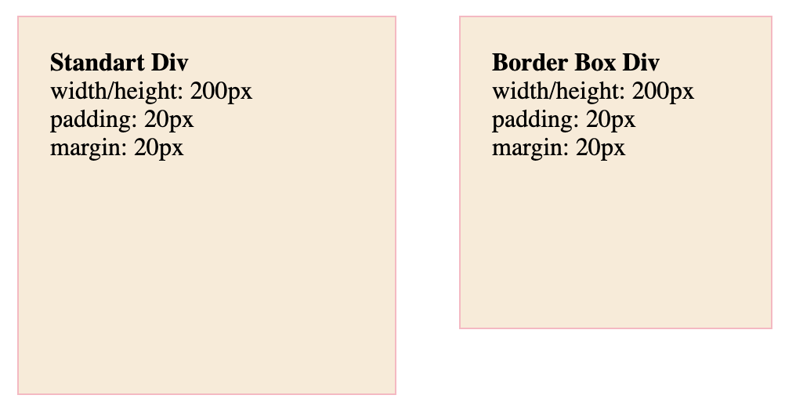
BORDER-BOX
box-sizing: border-box;
242px

Slide 27
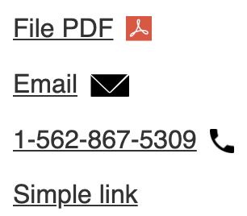
Links
a[href$=".pdf"] {
&:after {
background: url(./img/icons/icon_pdf.png) no-repeat;
background-size: contain;
width: 16px;
height: 16px;
}
}
a[href^="tel:"] {
&:after {
background: url('./img/icons/icon_phone.png') no-repeat;
background-size: contain;
width: 15px;
height: 15px;
}
}
a[href^="mailto:"] {
&:after {
content: url('./img/icons/icon_envelope.svg');
}
}

Slide 28
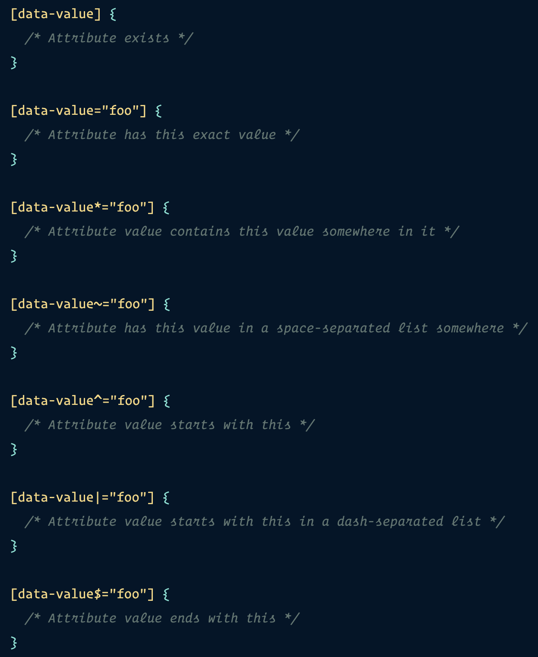
CSS Attributes

Slide 29
HTML/CSS - Tricks
PROJECT OVERVIEW BY Shevchenko roman

